Slide 1
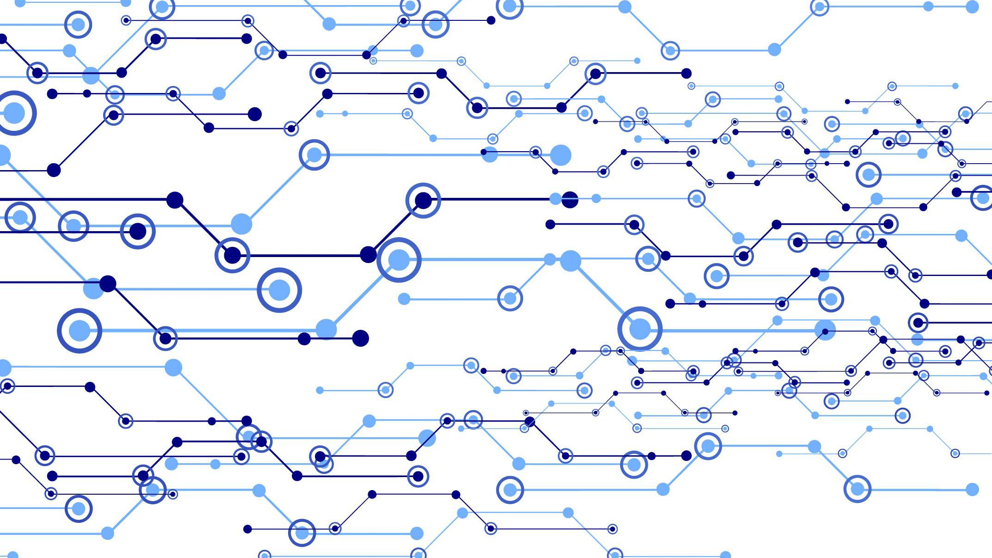
Project Week 1
Day 24 | Data Analytics & Visualization Bootcamp | Jan 8, 2019

Slide 2
Objectives
Git review
Project details
Split into teams
Setup team repo
Define project proposals

Slide 3
Git Overview

Slide 4
GIT
A version-control system for tracking changes and coordinating development work among a team of developers

Slide 5
From development to remote repository
git add
git commit
git push
Image credits: https://medium.com/@ashk3l/a-visual-introduction-to-git-9fdca5d3b43a

Slide 6
Git workflow
Working Directory
Staging Area
Local Repo
Remote Repo
git add
git commit
git push
git pull
Local Network
External Network

Slide 7
Git Branching
It is not required to utilize branching for project #1
Branching allows us to keep our development work organized, while also allowing us to isolate our experimental analysis & bug fixing from the master
Let’s assume that in Master v2 we’ve finally modeled the data into a state that is ready for analysis
VP_Analysis
v1
VP_Analysis
v2
Once a developer is happy with their local development, they’ll perform a merge to merge their branch with the master branch
VP_Analysis
At this point, a completely new branch can be created for the development of the next analysis feature
Master
Master
v1
Master
v2
Master
v3
Master
v4
CC_Analysis
v1
CC_Analysis
v2
CC_Analysis
v3
Now once CC_Analysis is merged, git will perform a check for conflicting code and allow us to correct any conflicts
CC_Analysis
…
When a branch is created, it will contain an exact copy of the latest master files, and it will not be visible by teammates
Each version here is representative of a commit, which can be thought of as checkpoints
Although master has been updated, CC_Analysis is still working with files from v2

Slide 8
Branch Demo

Slide 9
Project

Slide 10

Project Week! (This Week)
Today’s Class:
Overview of Git
Divide into groups
Begin researching data sets
Outline project ideas
Submit Project Proposal for Approval
Initial data exploration
Next Class:
Hardcore Development
Saturday’s Class:
Hardcore Development

Slide 11
Project Week (Next Week)
Next Week (M/T):
Hardcore Development
Next Week (W/Th)
Hardcore Development
Presentation Prep
Saturday’s Class:
Presentations!

Slide 12
Requirements

Slide 13
Development Requirements
Use Pandas to clean and format your data set(s)
Create a Jupyter Notebook describing the **data exploration and cleanup** process
Create a Jupyter Notebook illustrating the **final data analysis**
Use Matplotlib to create a total of 6-8 visualizations of your data (ideally, at least 2 per "question" you ask of your data)
Save PNG images of your visualizations to distribute to the class and instructional team, and for inclusion in your presentation
Optionally, use at least one API, if you can find an API with data pertinent to your primary research questions
Create a write-up summarizing your major findings. This should include a heading for each "question" you asked of your data, and under each heading, a short description of what you found and any relevant plots.

Slide 14
Presentation Requirements
You will also be responsible for preparing a 10 minute presentation.
This will be a formal presentation.
One in which you explain in detail:
The questions you and your group found interesting, and what motivated you to answer them
Where and how you found the data you used to answer these questions
The data exploration and cleanup process (accompanied by your Jupyter Notebook)
The analysis process (accompanied by your Jupyter Notebook)
Your conclusions. This should include a numerical summary as well as visualizations of that summary
Discuss the implications of your findings. This is where you get to have an open-ended discussion about what your findings "mean
Q&A session to follow your presentation

Slide 15
Be Glam for the Cam(era)
All presentations will be recorded…
Treat it seriously!
These can be great portfolio pieces if you invest the time.

Slide 16
Suggested Data Sources

Slide 17
Suggestions for Data Sources
Stick to data sources that:
Are sufficiently large
Have a consistent format
Ideally contain more data than needed
Are well-documented
Feel free to ask your instructors for input!

Slide 18
Example Project Ideas

Slide 19
Private Investigator
Use aggregate crime data from different police precincts in a city to uncover patterns in criminal activity.
Most crime in NYC takes place in the summer. Can you uncover similar patterns in your city of choosing?
What do your results suggest about how police should plan their patrols? About how best to distribute law enforcement resources over the calendar year?

Slide 20
Uber Rides & Weather
Do people use Uber more during subzero temperatures or scorching heat?
Using Uber ride data from Kaggle and data from a weather API, find out if people take Uber more during summer and winter; and if there are relationships between daily temperature and ride frequency.
What do the results tell you about surge pricing strategies and commuter habits?
Are there any ethical concerns with surge pricing during extreme weather? Or is it just a business capitalizing on demand?

Slide 21
Bullying & Crime Rates
Bullying and violent crime seem like they should be related. Can we find a correlation between frequency of bullying rates of violent crime?
Using Data.gov’s data on bullying and data from police districts of your choosing, investigate relationships between bullying and violent crime frequency and location (zip code, city, etc.)
Do these two activities track each other? What do the results suggest about society and public policy?

Slide 22
Today’s Focus

Slide 23
By End of Day - Today
Brainstorm possible ideas
Begin Data Research
Write a description of the scope of your research
Create a short 1 page proposal listing out each of the following:
Project Title
Team Members
Project Description/Outline
Research Questions to Answer
Data Sets to be Used
Rough Breakdown of Tasks

Slide 24
Questions
(not about teams)

Slide 25
Teams

Slide 26
Teams
Team #1
Amy, Charles, Jason
Team #2
Ahmeda, Greg, Amrit
Team #3
Mahtab, Luke, Molly
Team #4
Dale, Hubert, Maddie
Team #5
Lee, Jordan, Diana
Team #6
Yang, Ziang, Erik D
Team #7
Mike, Raphael, Mark
Team #8
Kabrina, Omar, Grace
Team #9
Eric F, Carlos, Sujin

Slide 27
Break
Sit with your team when you return

Slide 28
Create a team repo
Choose one person from each team to follow along to create a team repo.
Once created, we will perform these tasks AS A CLASS:
Add each member as a collaborator
Clone the repo to each member’s local computer
Update the README.md file to contain each of your names
Push the updated README.md to your repo

Slide 29
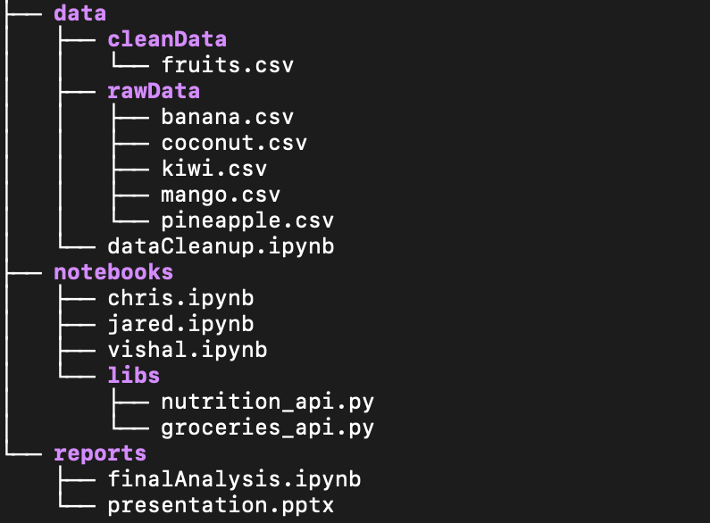
Data used for the analysis, after it has been cleansed
Example Project Structure
Data in its raw form straight from the source
Notebook to cleanse and format the data
Working notebooks for each team member
Custom scripts used by each member (i.e., API calls)
Final consolidated notebook and other reports

